Slide 1

GROUP number 03.
STUDENT NAME | REGISTRATION NUMBER
HAFIDH MWITA HAJI | BITAM/11/23/099/TZ
HALIMA AMEIR JUMA | BITAM/11/23/074/TZ
HARITH MAKAME | BITAM/11/23/059/TZ
HARITH OMAR | BITAM/11/23/056/TZ
HAFSA SAID ALI | BITAM/11/23/003/TZ
HEMED HUSSEIN PANDU | BITAM/11/23/032/TZ
HEMED SAID MMAKA | BITAM/11/23/001/TZ
IBRAHIM ASAA MO’HD | BITAM/11/23/073/TZ

Slide 2
INTRODUCTION
Business Intelligence (BI) helps transform raw data into meaningful information for better decision-making. In education, analysing student performance data enables institutions to identify academic trends and improve learning outcomes. This project uses Microsoft Power BI to analyse the Students Performance in Exams dataset, identify performance patterns, compare student groups, and provide insights and recommendations to improve student academic outcomes.
Business Intelligence (BI) provides techniques and tools that transform raw data into useful insights through data collection, processing, analysis, and visualization

Slide 3
PROBLEM STATEMENT
Educational institutions collect large amounts of student examination data, but it is often underutilized for decision-making. Without proper analysis, it is difficult to identify performance trends, students at risk of failure, and the factors affecting achievement in Mathematics, Reading, and Writing. Therefore, this project uses Microsoft Power BI to analyze student performance data, generate meaningful insights, and support data-driven decisions to improve academic outcomes.

Slide 4
METHODOLOGY
This project was conducted using Microsoft Power BI Desktop. The dataset was imported and cleaned using Power Query by correcting data types, removing duplicates, and handling missing values. A Star Schema was created with one fact table and supporting dimension tables. Custom DAX measures were developed to analyze student performance, and interactive dashboards were designed to answer the business questions and provide data-driven insights.

Slide 5
OBJECTIVE
The objective of this project is to design and develop an interactive Business Intelligence dashboard using Microsoft Power BI to analyze student academic performance. The project aims to identify factors affecting student achievement, evaluate the impact of test preparation programs, compare performance across Mathematics, Reading, and Writing, and provide data-driven insights and recommendations to support better educational decision-making.

Slide 6
DATA PROFILE
The dataset used in this project contains student academic performance records along with demographic and socioeconomic information. It includes attributes such as gender, race/ethnicity, parental level of education, lunch type, test preparation course status, and examination scores in Mathematics, Reading, and Writing. These variables were analyzed to identify performance trends and the factors influencing student academic achievement.

Slide 7
DATA ENGINEERING AND POWER QUERY TRANSFORMATION
Data Import and Primary Key Creation
The Students Performance in Exams dataset was imported into Microsoft Power BI Desktop using Power Query. Since the original dataset did not contain a unique identifier for each student, a surrogate key named Student_ID was created using an Index Column. This key was used to uniquely identify each student and establish relationships between the fact and dimension tables.

Slide 8
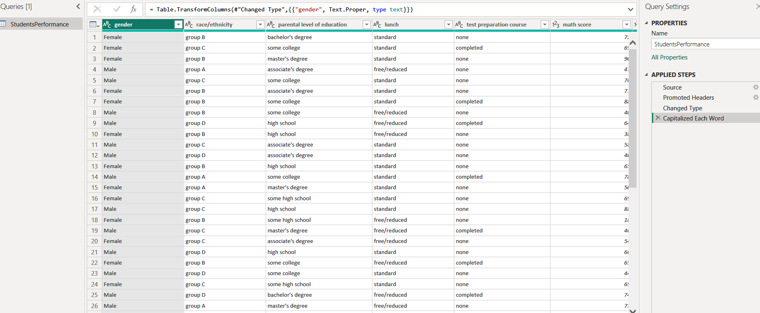
Data Cleaning and Standardization
The dataset was cleaned by removing duplicate records, checking for missing values, correcting data types, and standardizing text fields. Column names were renamed to meaningful names, and categorical values such as Gender, Race/Ethnicity, Parental Level of Education, Lunch, and Test Preparation Course were formatted consistently to improve data quality and analysis.
WEKA IMAGE

Slide 9
Data Type Transformation
All examination score columns (Math Score, Reading Score, and Writing Score) were converted to Whole Number data types to ensure accurate calculations. Text columns were assigned the Text data type, allowing Power BI to perform reliable filtering, grouping, and reporting.

Slide 10
Data Modelling and Query Transformation
To improve performance and support a Star Schema design, the original dataset was transformed into multiple related tables using Power Query references:
Dim_Student:Contains student demographic information, including Student_ID, Gender, Race/Ethnicity, Parental Level of Education, and Lunch Type.
Dim_Course:Contains information about students' Test Preparation Course status (Completed or None).
Fact_Performance: Stores the measurable data, including Student_ID, Math Score, Reading Score, Writing Score, and the calculated Average Score. This table serves as the central fact table for analysis and is linked to the dimension tables through Student_ID.

Slide 11
DATA MODELING AND ARCHITECTURE (THREE-TABLE STAR SCHEMA)
Normalized Design Justification
Standard flat database files force the calculation engine to run highly inefficient whole-table scans. Transitioning to a normalized three-table Star Schema maximizes cache efficiency and dramatically decreases query optimization latency.

Slide 12
Table Segmentation Inventory
Dimension Table (Students): Hosts rows defining structural client attributes (Gender, Race_Ethnicity, Parental_Education, Lunch).
Dimension Table (Courses): Hosts lookup attributes for academic fields (Course_Code, Course_Name, Department).
Fact Table (Results): Restricts observations strictly to numerical outcomes (Score), programmatic variables (Test_Prep_Course), and engineered operational groupings (Lecturer).

Slide 13
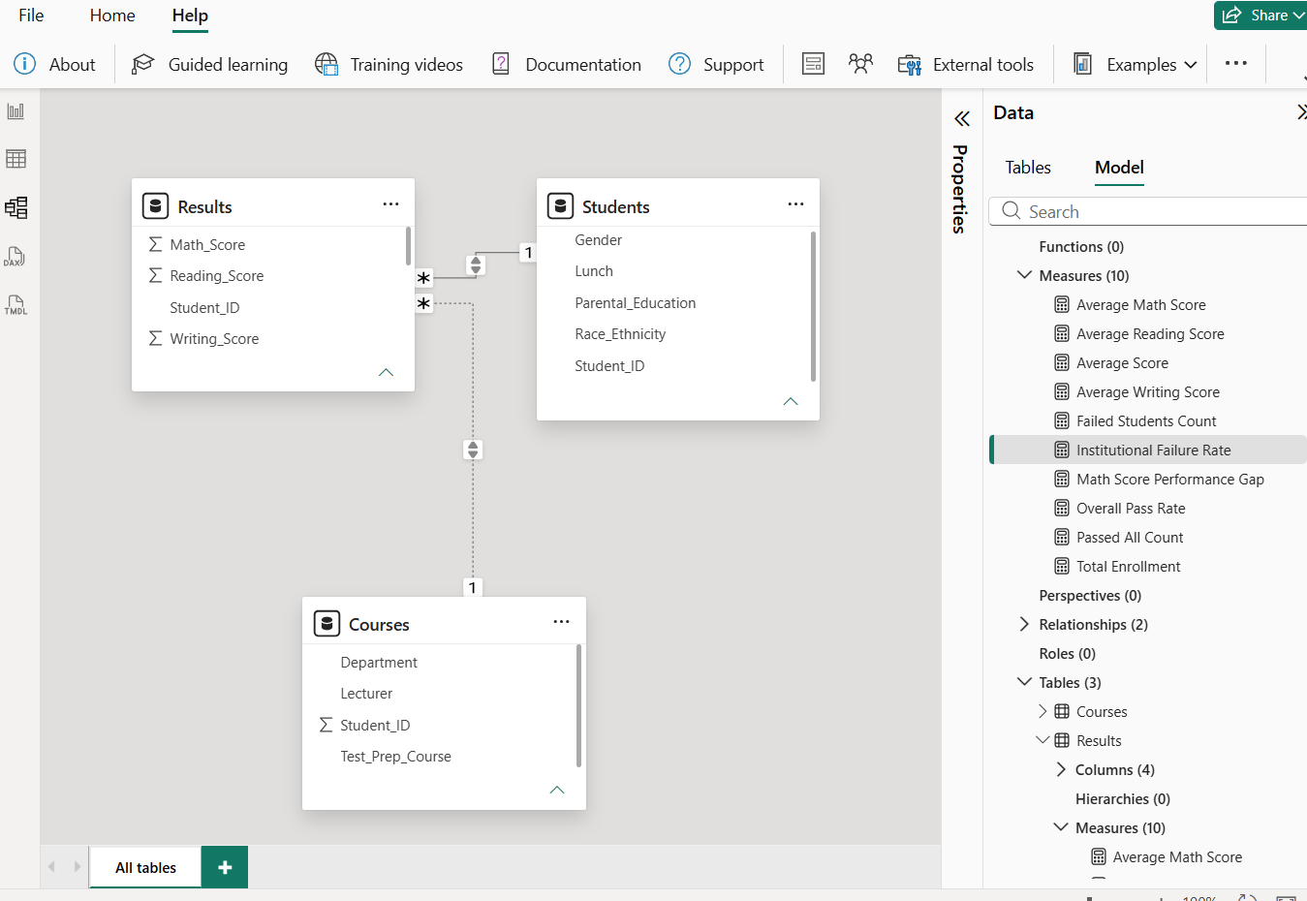
Relationship Topology
The tables are bound together on the relationship canvas using a strictly configured One-to-Many (1 *) link over the shared keys. There is no direct relationship between the students table and the Courses table; instead, both act as lookup tables that filter down into the central Results fact table. Cross-filter directionality is mapped as moving downwards from the dimensions to the fact ledger, forcing filter contexts to cascade cleanly across all visual slices.
WEKA IMAGE

Slide 14
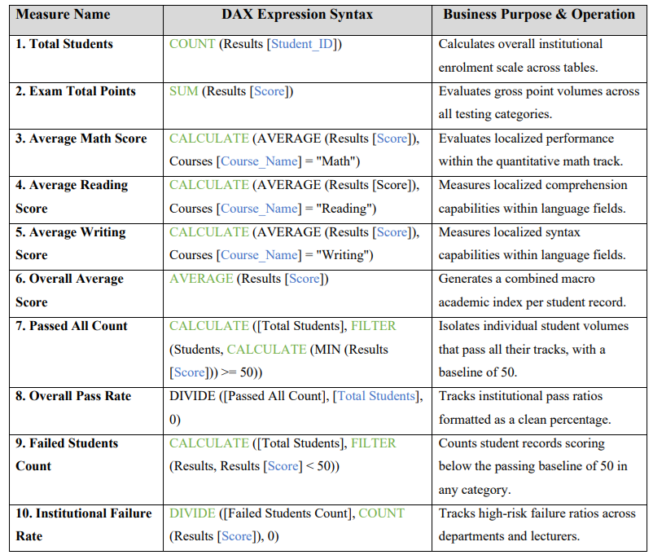
THE DAX MEASURE FRAMEWORK AND METRIC CALCULATIONS
Analytical Inventory
The following 10 specialized Data Analysis Expressions (DAX) were engineered into the model to run clean aggregations across the normalized three-table schema:

Slide 15
INTERACTIVE DASHBOARD ARCHITECTURE
School Board Executive Overview (Enrolment)
Visual Intent: To provide senior stakeholders with a quick health check of baseline institutional enrolment and demographic metrics.
Layout Mechanics: Places dropdown slicers from the students table for Gender and the Results table for Test_Prep_Course at the top boundary. Below, summary KPI cards list primary enrolment, average grade values, and pass rates. A donut chart maps out demographic splits by gender, while a horizontal clustered bar chart ranks performance metrics across ethnic categories.

Slide 16
Performance Variances (Performance)
Visual Intent: To track the direct relationships between external household factors and actual classroom grades.
Layout Mechanics: Employs a clustered column chart tracking Overall Average Score together across the X-axis categorized by Students [Parental_Education]. The base of the page features a financial matrix tracking Students [Lunch] status metrics, allowing seamless cross-filtering across the schema.

Slide 17
Department Performance Analytics
Visual Intent: To identify the best-performing academic sectors and contrast score reactions.
Layout Mechanics: Features an overall pass rate KPI card. The primary visual space contains a Clustered Column Chart with Courses [Department] on the X-axis and [Overall Average Score] on the Y-axis to clearly showcase that the Department of Humanities is the top department. A vertical slicer selection lists Results [Test_Prep_Course] for dynamic filtering.

Slide 18
Lecturers Performance Analytics
Visual Intent: Identify individual instructor impact and high-risk classroom failure points, focusing on Dr. Hemed. Mmaka failure rate of 24.64%. Provide insights for targeted teaching.
Layout Mechanics: Top Summary Cards: Display total active lecturers, average student score, and highest classroom failure rate. • Primary Chart (Clustered Bar Chart): Y-axis: Results[Lecturer]; X-axis: [Institutional Failure Rate] to highlight outlier failure profiles. • Drill-Through Integration: Allows stakeholders to right-click on a lecturer’s name and access their detailed scorecard.

Slide 19
BUSINESS INSIGHTS AND EMPIRICAL FINDINGS
The Socioeconomic Performance Gap: Reviewing the cross-filtered data in the financial matrix reveals a noticeable performance drop among students matching the free/reduced lunch proxy. This confirms that external economic constraints correlate closely with testing outcomes.

Slide 20
Best Department Performance
The department column chart empirically proves that the Department of Humanities is the top academic sector, maintaining a leading institutional score average of 72.63% driven by strong language arts baselines.
High-Risk Classroom Failure Vector
The lecturer scorecard isolates a critical performance gap under Dr. Hemed. Mmaka within the quantitative track, showing a high-risk failure profile that peaks at an institutional failure rate of 24.64%.

Slide 21
RECOMMENDATION AND ACTION PLAN
Targeted Academic Resource Allocation: Deploy specialized learning hubs and peer tutoring labs specifically tailored to support students from tracking vectors flagged under Dr. Hemed. Mmaka classroom domain.
Automated Intervention Placement: Given the proven success of the test preparation course, the school board should automate enrolment or provide direct subsidies for students flagged under lower financial proxies (Students [Lunch]).
Early-Warning Alert Protocols: Use the dashboard's underlying data model to set up early alerts. If a student's rolling score within the Results table dips below the 50-point passing threshold, the system automatically flags them for proactive counsellor review.

Slide 22
CONCLUSION
Project Synthesis: This implementation demonstrates how enterprise BI workflows can transform static student rows into actionable institutional strategies. By shifting from a flat data layout to a structured three-table Star Schema (Students, Courses, Results), administrators can confidently track performance drivers and lecturer metrics in real time.
System Boundaries & Future Enhancements: The current data model is limited by its static nature, lacking historical trend lines over multiple semesters or attendance records. Future development cycles should focus on ingesting time-series data to track student growth over multiple years.

Slide 23
THANK YOU

